Slide 1
BA with R Group Project Final Report
Group 11
ShenJun Liu - sxl200043
Zhang Li- lxz200000
Srishti Vinaik- sxv210063
Fayad Hasan Khan- fxk200001

Slide 2

Introduction
Data Visualization and Exploration
Summary statistics
Lowering impacts of outliers
Wine quality distribution
Correlation
Data Mining
Clustering
Classification
Linear Regression
Logistic Regression
Findings and Recommendations
Appendix

Slide 3
INTRODUCTION
Red wine is one of the most favored types of alcoholic drink in the United States where it consumes the largest volume of wine of any country, at 33 million hectoliters in 2020.
Vinho Verde is a unique wine product from the Minho (northwest) region of Portugal. The general impression of the type of wine is described as light and fresh,complex, structured and mineral.
Vinho Verde wine quality can be determined by numeric variables which can be measured by physicochemical tests. Physicochemical tests, which are laboratory-based and take into consideration elements such as acidity, pH level, presence of sugar, and other chemical features, are another important factor in wine certification and quality assessment. The human quality of tasting might be linked to wine's chemical attributes so that the certification and quality assessment and assurance process is more controlled.The test seems to provide a more objective result than people’s feelings do.
What we are concerned about is the physicochemical tests of Vinho verde wine: What attributes determine the Vinho Verde wine? Can we use the results to predict human wine tasting reference?
To answer the questions, we need to find out whether different levels of wine quality share the same degree of attributes. We also need to find relations between attributes and wine quality. Lastly, It is necessary to know to what extent the level of wine quality can be predicted by wine attributes. After all the analysis, we will give a finding summary in regards to what we observe from the outputs and recommendations on how to improve the wine production.

Slide 4
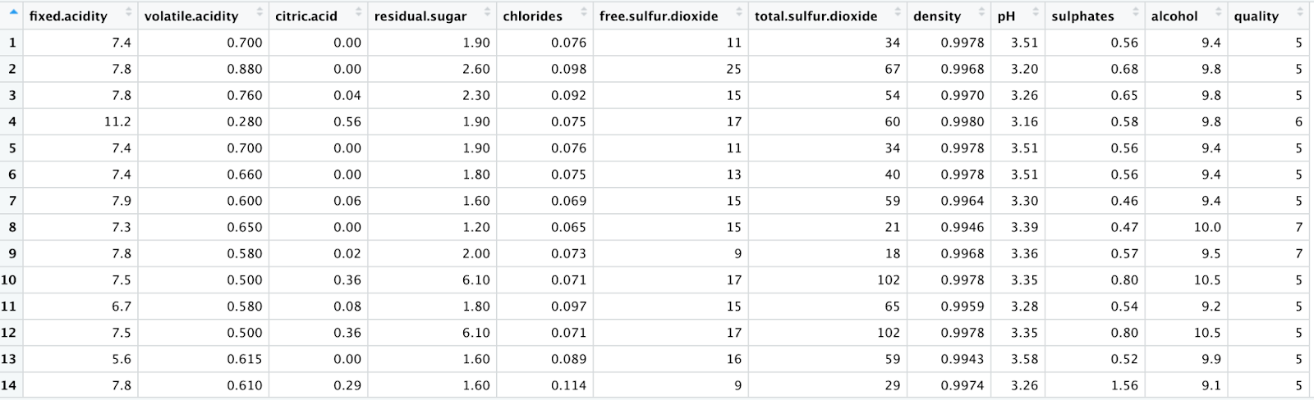
DATA VISUALIZATION AND EXPLORATION
The dataset is taken from the UCI machine learning repository website.
There are 12 attributes in the dataset that cover the features of each red wine along with the quality score.
All attributes’ characteristics are numerical. The number of observations is 1599.
There is no missing value in the dataset.

Slide 5
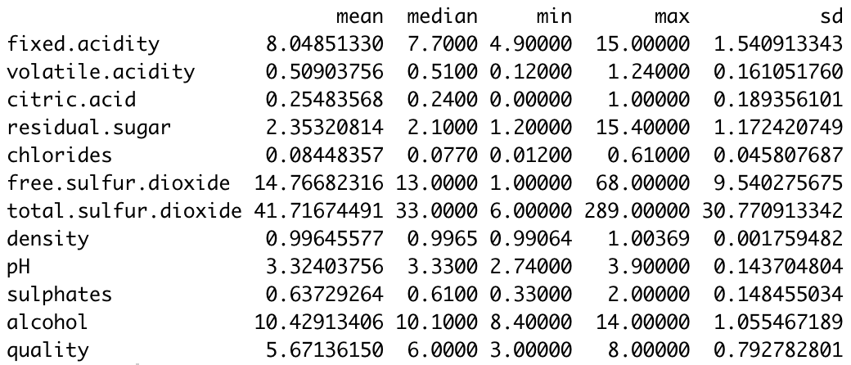
Summary statistics
From observing the results of the summary statistics table, the variables except total sulfur dioxide and free sulfur dioxide have relatively smaller standard deviations, which means the values are more concentrated than those two variables. Also, total sulfur dioxide and free sulfur dioxide have the largest range values, which are 283 and 67 separately.

Slide 6
Lowering impacts of outliers in each variable:
Data of Variables that need to be oversampled. Any data values of the seven variables which are out of the range between Q1-1.5*IQR and Q3+1.5*IQR will be chosen with 0.01 probability. The rest of the values will be chosen with 0.99 probability.
Fixed.acidity
Volatile.acidity
Residual.sugar
Chlorides
Free.sulfur.dioxide
Total.sulfur.dioxide
Sulphates

Slide 7
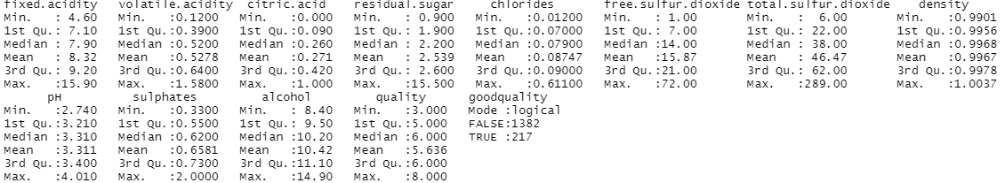
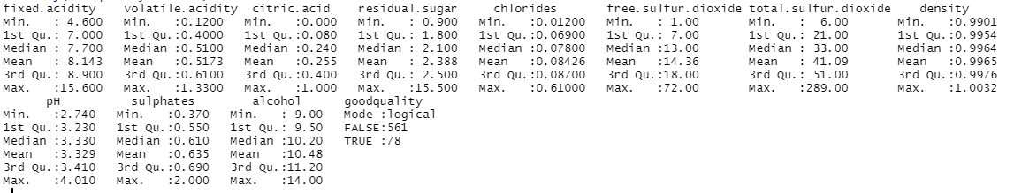
Lowering impacts of outliers in each variable:
Before oversampling
After oversampling:

Slide 8
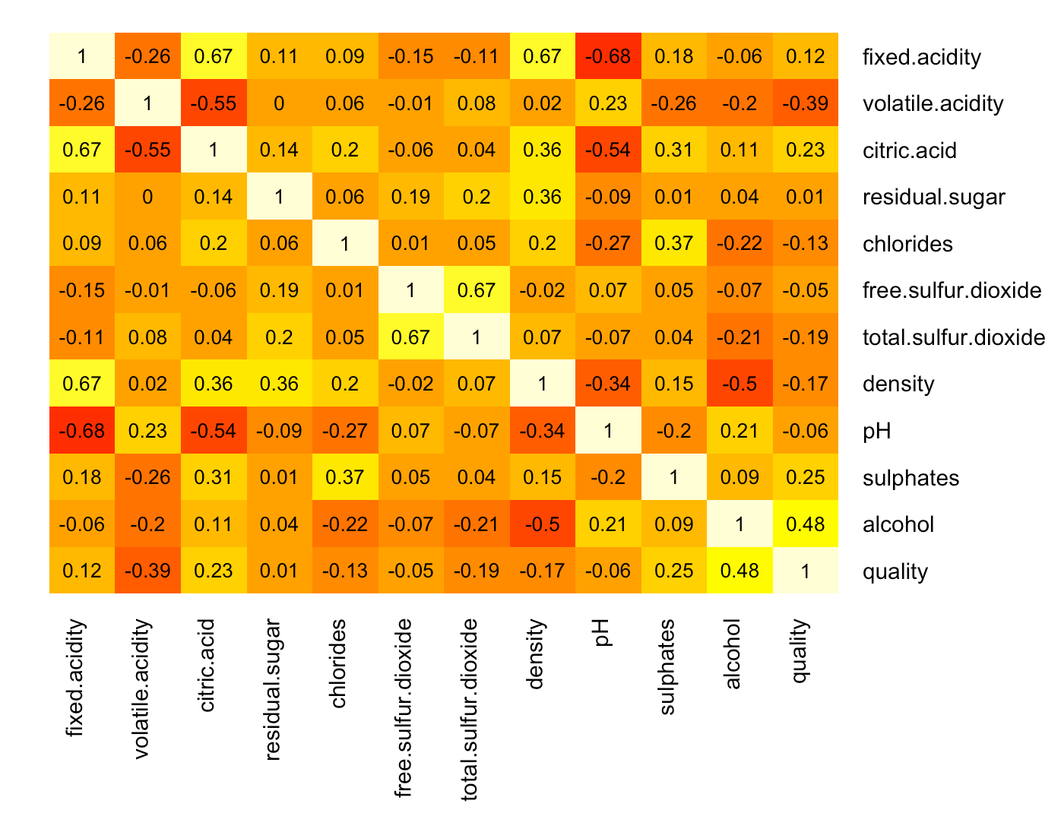

Correlation
Heat map of correlation tells the same story that volatile acidity has the strongest correlation with wine quality. Meanwhile, three kinds of acidity correlated with each other effectively. As winery want to make a good wine, it is important to control the level of volatile acidity by balancing the two other acidity to obtain a pleasant taste.

Slide 9
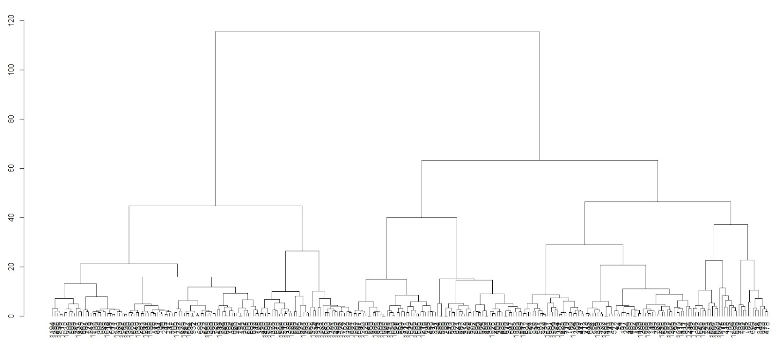

DATA MINING - Clustering
Try to find if red wines share the same attributes when they are at the same quality score range. 1599 observations
Randomly selecting 300 observations in 1599 observations.
Method: Ward distance

Slide 10
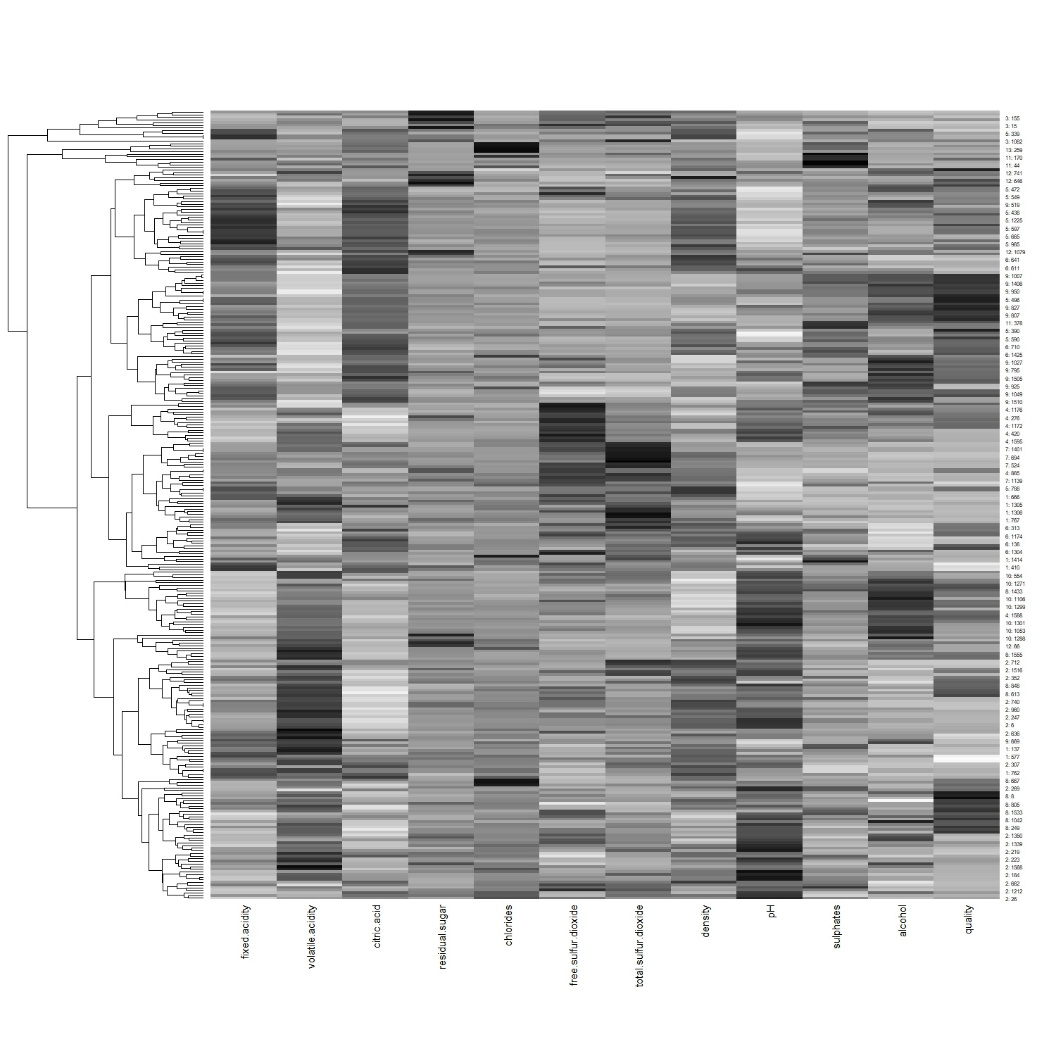
When set tree height ( h= 20), 13 clusters are generated

Slide 11
DATA MINING - Clustering
high quality clusters usually share the same features

Slide 12
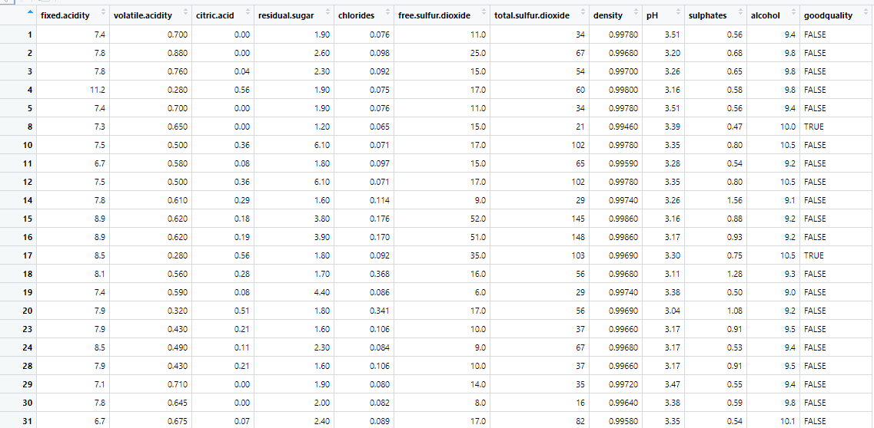
Classification
Training dataset and validation dataset set up with 4:6 separated ratio.
Created new variable to illustrate whether the wine belongs to good quality or bad with column name “good quality”.

Slide 13
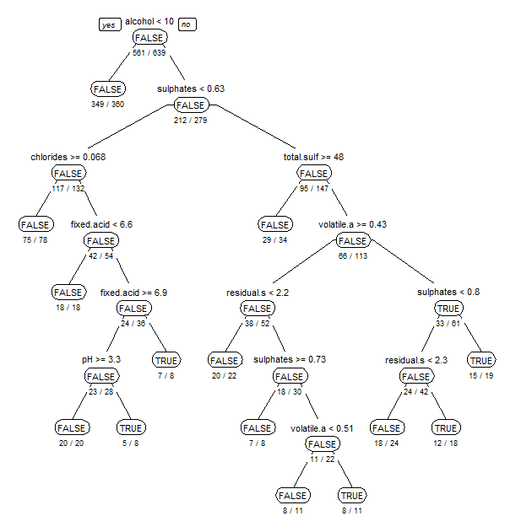
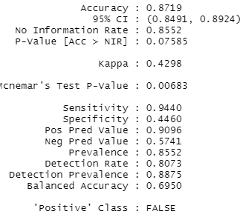
Classification
Training dataset Generate model in training dataset, verify in validation dataset
Accuracy Rate: 0.8719
After cross-validation, accuracy no change.

Slide 14
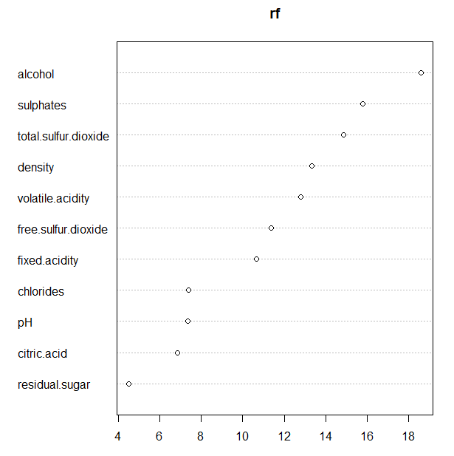
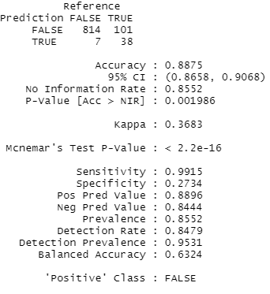
Classification – Decision Tree
Random forest tree result:

Slide 15
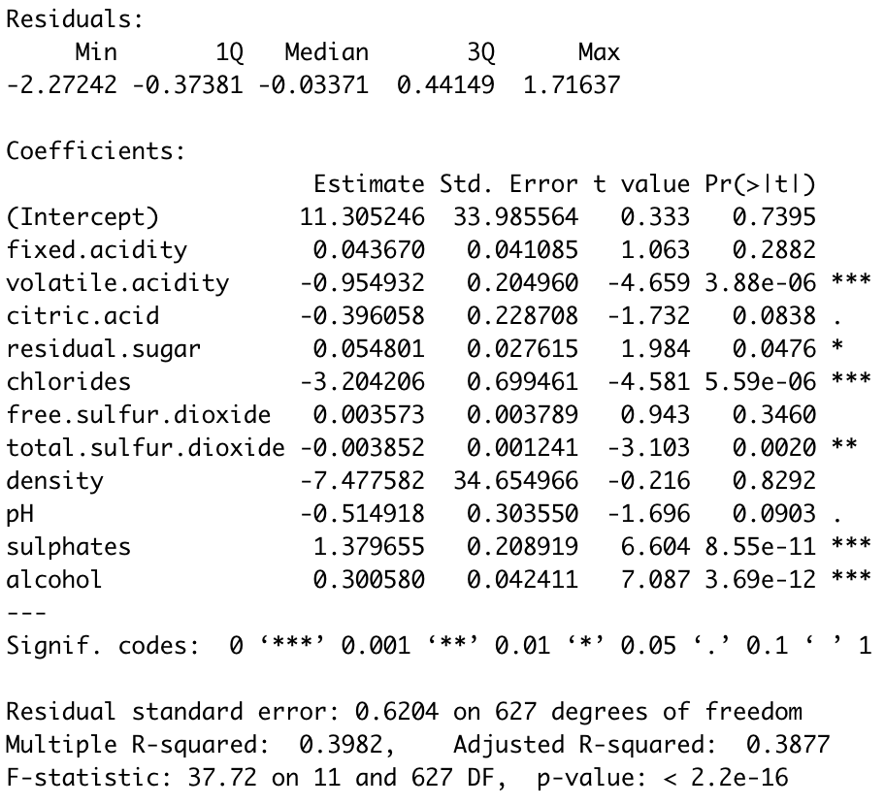
Linear Regression
From linear regression, we can observe volatile acidity, citric acid, residual sugar, chlorides, total sulfur dioxide, pH, sulphates and alcohol are significantly correlated with dependent variables at a 10% significant level. Among them, residual sugar, sulphates and alcohol are positively correlated, which means as the increase of these variables, Quality increases, while the other variables are negatively correlated. And for this model, the adjusted R-squared is 0.3877, which means about 38% of quality value is explained by independent variables.

Slide 16
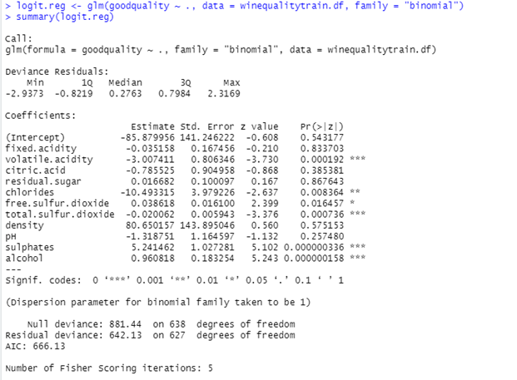
Logistic Regression
A technique used by marketers to assess the scope of customer acceptance for a product.
Goal: Identifying the best possible model with the attributes that contribute to the quality of wine.
The effects of attributes on the response variable varies significantly.

Slide 17
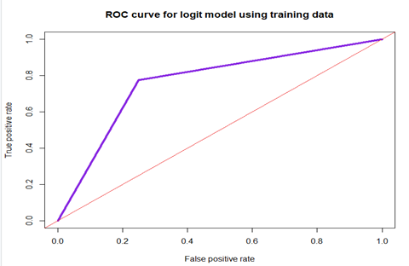
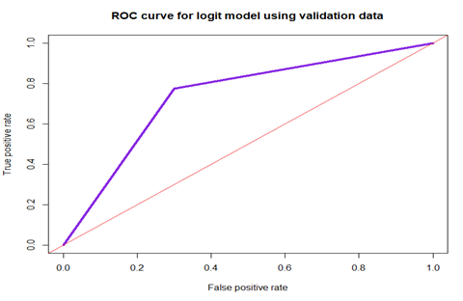
Logistic Regression contd.
Performing different selection process to determine best fit model for the dataset.
Lower the AIC value, better is the model.
Comparing performance of the logit model.
Plotting the ROC curves.

Slide 18
Logistic Regression contd.
Key takeaways:
We get a best fit model which has an accuracy of 76%.
Attributes that contributed the most - Alcohol, volatile acidity, sulphates, chlorides, total sulfur dioxide, and free sulfur dioxide.
Increase the content of alcohol, sulphates and free sulfur dioxide in wines.
Decrease in the content of chlorides, volatile acidity and total sulfur dioxide in wines.

Slide 19
Findings
The dataset includes three different kinds of acidity: fixed acidity, volatile acidity, and citric acid. According to the variable explanation, volatile acidity provides wine the unpleasant vinegar taste.
Heat map of correlation tells the same story that volatile acidity has the strongest correlation with wine quality. Meanwhile, three kinds of acidity correlated with each other effectively. As winery want to make a good wine, it is important to control the level of volatile acidity by balancing the two other acidity to obtain a pleasant taste.
We have 12 different attributes that contribute to the quality of wine in one or the other way, but the attributes that play an important role in predicting the quality of wine are total.sulfur.oxide, free.sulfur.dioxide, sulphates, alcohol, chlorides and volatile.acidity. Their concentration level in the wine varies significantly.
Free.sulfur.dioxide and total.sulfur.dioxide are associated with the concentration of SO2 in the wine where they are to be present in high and low levels respectively in wine to produce a good quality wine.
Alcohol and quality are strongly related as higher the concentration of alcohol content in wine, higher would be the quality of wine. This is also the most important variable that affects the quality of wine based on classification analysis.

Slide 20
Findings
The quality of wine is affected not only due to the presence of these different attributes in a wine but mainly due to the concentration of these attributes.
As individuals have different tastes so these attributes should be adjusted in such quantities in wine production so that people get more attraction towards trying wines.
Thus, the best business model is one which has a great market value as well as popular in most of the sphere.

Slide 21
Recommendations
Alcohol content must be higher than 10.
Quantity of Sulphates should be higher than 0.8, for maintaining long lasting fragrance and the good body of wine.
Range of Fixed acid in wines should be between 6.6 and 6.9.
Sugar level should be higher than 2.3. A good wine with tiny sweetness helps release of wine fragrance.
Volatile acidity should not exceed 0.43 in wines as it will affect the acid balanceness.
Increase citric acid levels to some extent for manufacturing different flavors of wines. It would increase market value for the business.

Slide 22
Thank You.

